Slide 1
Cuffless estimation of blood pressure from PPG signals using Transformers
05/07/2022
Arijit Bhattacharyya
Supervisors: Dr Zaibaa Patel, Professor Esther Rodriguez Villegas
Second marker: Dr Christos Bouganis

Slide 2
Contents
Background
Analysis and design of the system
Proposed Model (Demonstration)
Results
Conclusion

Slide 3
Blood Pressure
Blood Pressure Category | Systolic Blood Pressure (mmHg) | AND/OR | Diastolic Blood Pressure (mmHg)
Hypotension | ≤ 90 | OR | ≤ 60
Normal | 90-120 | AND | 60-80
Prehypertension | 121-139 | OR | 81-89
Stage 1 Hypertension | 140-159 | OR | 90-99
Stage 2 Hypertension | ≥ 160 | OR | ≥ 100
Ludi Wang et al. “A novel neural network model for blood pressure estimation using photoplethesmography without electrocardiogram”. In: Journal of Healthcare Engineering 2018 (2018). issn: 20402309. doi: 10.1155/2018/7804243

Slide 4
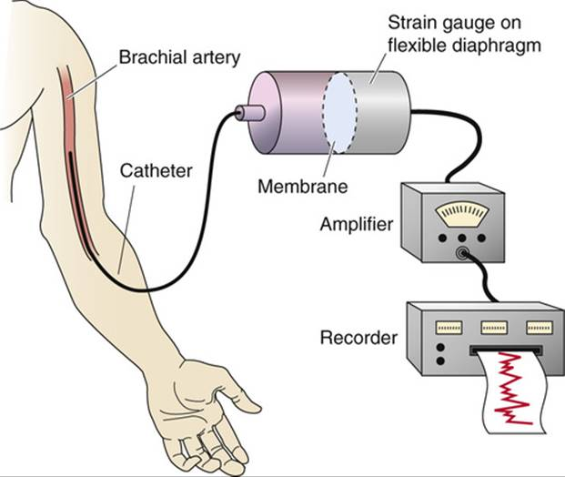
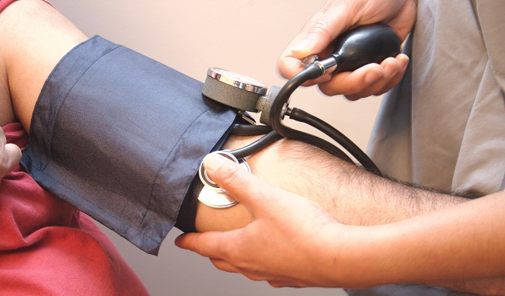
Continuous Blood Pressure monitoring
Invasive
Limited to clinical environments (e.g in ICU)
Discomfort
May cause complications
Non-invasive
Cumbersome due to repeated inflation and deflation
Inaccurate
Not feasible for long term monitoring
A better method is required!
https://doctorlib.info/physiology/medical/96.html
https://www.tctmd.com/news/cuff-bp-more-variable-intra-arterial-measures

Slide 5
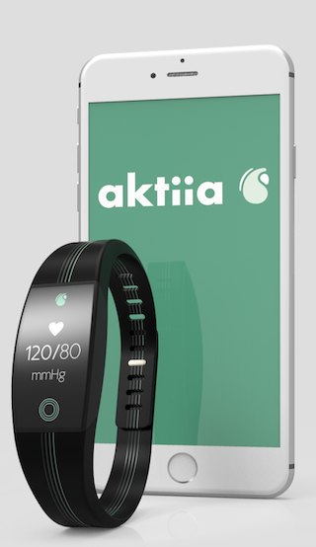
Continuous Blood Pressure monitoring
Wearables
Several existing smart watch models:
Aktiia
Heartisans BP smartwatch
BPro, developed by HealthSTATS Technologies
Still inaccurate
Potential for use in long term BP monitoring
https://aktiia.com/uk/
Face power limitations, important to consider:
Maximising accuracy
Minimising computational complexity

Slide 6
Aims
Develop a novel algorithm in software to perform cuffless estimation of blood pressure values using PPG signals
Algorithm should aim to:
Maximise prediction accuracy
Minimise computational complexity

Slide 7
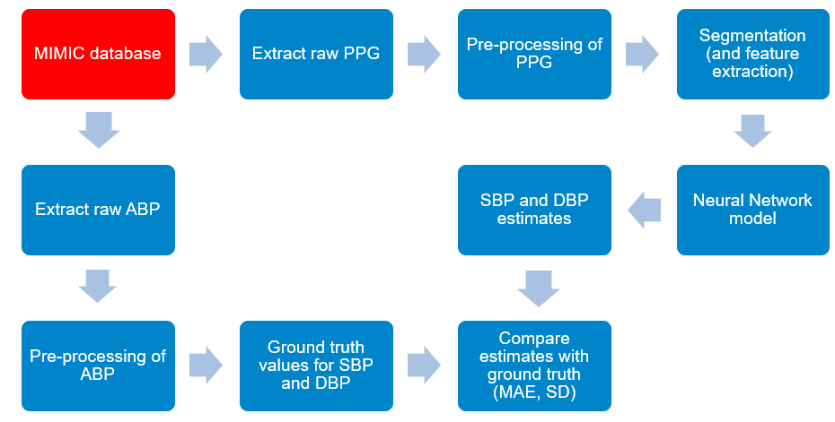
Pipeline for Cuffless BP estimation from PPG

Slide 8
Photoplethysmography (PPG)
An optically obtained signal that can be used to detect blood volume changes
Measured noninvasively
Potential to be used in future wearable technologies
https://en.wikipedia.org/wiki/Photoplethysmogram

Slide 9
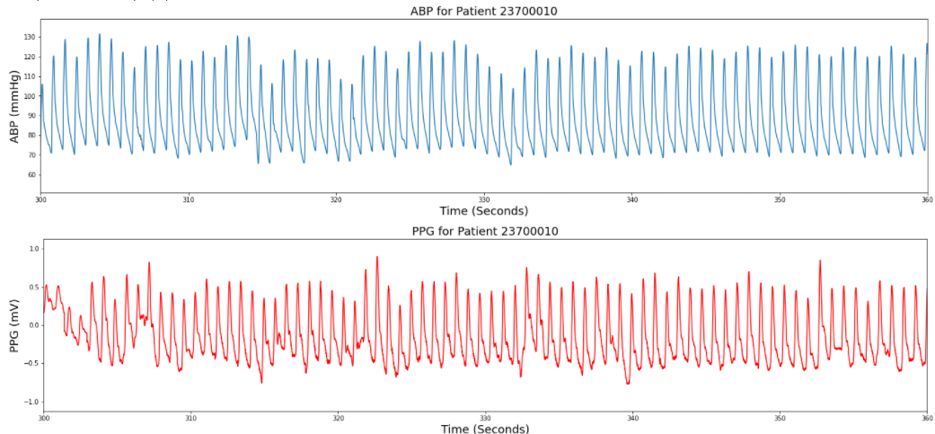
Photoplethysmography (PPG)
Contains information on cardiovascular parameters such as BP
Has high correlation with BP in both the time and frequency domains

Slide 10
Database
Multiparameter Intelligent Monitoring in Intensive Care (MIMIC) database
PPG and correspondent arterial BP signals
Data taken from 72 ICU patients
Data divided into 1-second windows

Slide 11
Dataset Noise
Signals in this dataset often contain significant artifacts
Physiologically improbable BP values
Improbable Normal-to-Normal (NN) intervals
Improbable heart rate values
Noisy PPG and BP signals (low frequency noise and baseline wandering)
Strong preprocessing is required

Slide 12
Preprocessing Steps
Remove unreliable patients and their data
Remove outliers
Z-score normalisation
4th order Butterworth bandpass filter

Slide 13
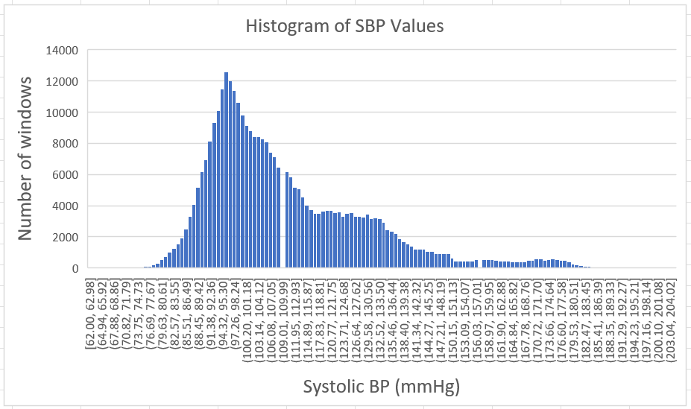
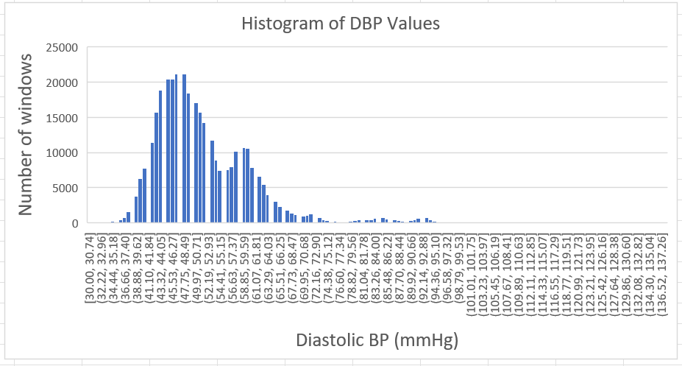
Preprocessed Dataset
- ~ 340,000 1-second windows from 12 different patients

Slide 14
Families of Neural networks
Review of literature resulted in 3 families:
Convolutional Neural Networks (CNNs)
Long Short Term Memory Recurrent Neural Networks (LSTM-RNNs)
Transformers using the Attention mechanism

Slide 15
Handpicked vs Automated Feature extraction
PPG
Handpicked Features
SVM
Bi-LSTM, Bi-GRU
Automated Feature Extraction
CNNs
RNNs
Transformer Encoder
AlexNet
Bi-LSTM
Attention
Auto-encoder
ResNet

Slide 16
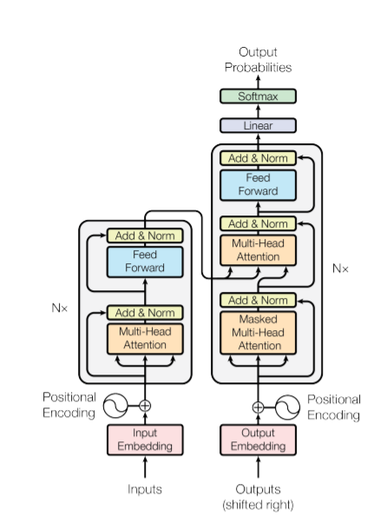
Transformers
Advantageous over CNNs and RNNs with large data inputs
Main components:
Layer Normalisation
Multi head Self Attention Mechanism
Feed forward neural network
Several parameters required to set up the network:
Head size, number of heads, number of convolutional filters, number of encoder blocks
Ashish Vaswani et al. Attention Is All You Need. 2017. doi: 10.48550/ARXIV.1706. 03762. url: https://arxiv.org/abs/1706.03762

Slide 17
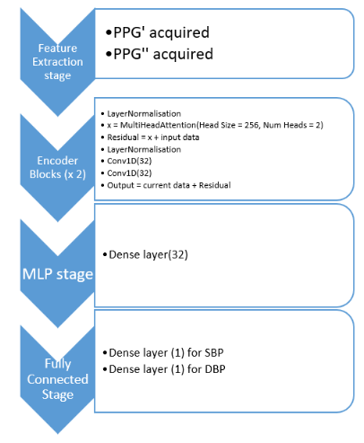
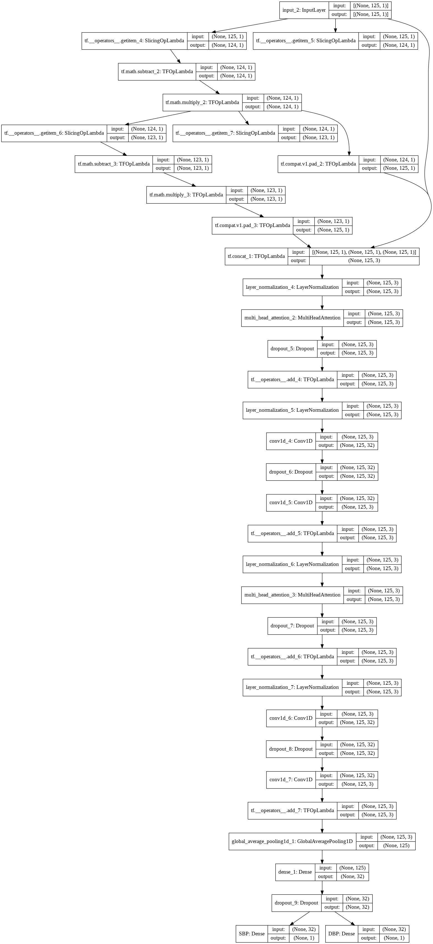
Proposed Transformer Encoder Architecture
Feature Extraction stage (optional)
PPG’ acquired
PPG’’ acquired
Encoder Blocks (x2)
LayerNormalisation
x = MultiHeadAttention(Head Size = 256, Num Heads = 2)
MLP Stage
Dense Layer (32)
Fully Connected Stage
Residual = x + input data
LayerNormalisation
Conv1D(32)
Conv1D(32)
Output = Current Data + Residual
Dense Layer (1) for SBP
Dense Layer (1) for DBP

Slide 18
Feature Extraction stage (optional)
PPG’ acquired
PPG’’ acquired
Encoder Blocks (x2)
LayerNormalisation
x = MultiHeadAttention(Head Size = 256, Num Heads = 2)
MLP Stage
Dense Layer (32)
Fully Connected Stage
Residual = x + input data
LayerNormalisation
Conv1D(32)
Conv1D(32)
Output = Current Data + Residual
Dense Layer (1) for SBP
Dense Layer (1) for DBP

Slide 19
Results
Neural Network Architecture | SBP MAE (mmHg) |  | DBP MAE (mmHg)
 | Training | Validation | Training | Validation
AlexNet | 4.5867 / 2.0134 | 4.6724/6.7865 | 3.5892/1.3424 | 3.7895/2.9451
ResNet | 7.7123/1.9845 | 9.8753/6.9732 | 6.0123/1.2765 | 10.297/2.2145
ST ResNet | 7.5329/7.4923 | 9.4234/9.5246 | 4.2154/3.7894 | 4.3785/3.9720
Bi-LSTM | 5.1370/5.1299 | 8.2793/8.2432 | 3.2159/3.7913 | 3.4196/3.5217
Transformer Encoder | 13.214/12.992 | 13/359/12.740 | 6.3412/6.4387 | 5.6129/5.4763
For each cell:
- (Result without PPG derivatives) / (Result with PPG derivatives)

Slide 22
Results
Neural Network Architecture | Inference Time (ms per test sample)
AlexNet | 0.5204
ResNet | 0.5756
ST ResNet | 0.5891
Bi-LSTM | 0.6043
Transformer Encoder | 0.3590

Slide 23
Conclusion
Two variants of the Transformer encoder technique have been proposed
First technique: Standard Transformer Encoder
Second technique: Addition of 1st and 2nd order derivatives of PPG
Compared against two other neural network families (CNNs, LSTMs)
Trained on a large dataset after extensive pre-processing
Further data required to compare with health standards
Potential to be used in future BP monitoring devices after further testing

Slide 24
Thank you for listening

